Slide 1
SQL Programming
Multiple Table Database Systems

Slide 2
Module 01: Multi-table Systems Page A-1: Intro
We just spent an entire semester manipulating and retrieving data from databases that were built around a single table.
You did good work. You learned a lot. And now you’re going to extend those skills to work in the realm of multiple-table databases.
By and large, multiple-table databases are the reality of modern database systems. Single-table databases are extremely rare. And as I look back on my experience, I can’t think of any single-table database system that I’ve ever used, let alone designed.
If my needs were so ‘trivial’ as to use a single-table database, I’d probably build the application in a spreadsheet. ☺
So let’s get started.

Slide 3
Module 01: Multi-table Systems Page B-1 Multiple Tables
Why are multiple-table databases the norm?
On the face of it, a single table is ever so much easier to understand. Why would we want to build a complicated multiple-table database structure?
Here’s the short story.
Universal Design Rule 1. Simple is better.
A single-table database devolves into a table that has everything, including the kitchen sink, thrown into it. When that happens, we wind up with an unwieldy and complicated structure. Think of it as being “too much to deal with”.
A properly designed multiple-table database logically arranges the data elements into separate and distinct tables such that “there’s a place for everything and everything has its place”.

Slide 4
Module 01: Multi-table Systems Page B-2 Multiple Tables
In this regard, a multiple-table database system is inherently simpler and more effective than a single-table database system.
And, a ‘properly’ designed multiple-table database system is effective, efficient, robust, and guaranteed to be free of certain update anomalies.
Effective – in the sense of being easy to use, data is where it belongs and the users ‘know’ where to go for that data.
Efficient – in the sense of well-performing. Like-related data elements are ‘close’ to one another, and generally, data doesn’t have to be gathered from ‘all over the place’ to satisfy an inquiry or an update..
Robust – in the sense of being adaptable to change. If new data requirements are identified the data model can be adapted to accommodate those needs.

Slide 5
Module 01: Multi-table Systems Page B-3 Insert Anomalies
A well designed multiple-table database system has been rigorously vetted through a process known as normalization.
This technique of data normalization is beyond the scope of this course, but you should understand the problems that are averted with a normalized database model.
Consider the data in the table on the left as representing all of the information in our Academic Information System.
INSERT Anomaly occurs when we can’t add information to the database, because we don’t have some other bit of information. If we were to add a new major: Software Engineering SE, we couldn’t represent it in this model. We can’t add the new SE information until we have students in that major who have completed some course work.

Slide 6
Module 01: Multi-table Systems Page B-4 Delete Anomalies
DELETE Anomaly occurs when we can’t remove some information from the database, because we would lose some other bit of information.
When Joe graduates (or drops out) we can’t remove his record, because we’d lose all of the information in our system about CS majors. If Joe’s record goes, we’d never know we offered the CS Major.
UPDATE Anomaly occurs when we have to process the same change repeatedly throughout the system. The problem is that we might ‘miss one’.
For example, Mary, the IDS major, decides to change her name to Merry. We have to process that change in three different places in the database, with the prospect of missing an update, and introducing an error into the system.

Slide 7
Module 01: Multi-table Systems Page B-5 Averting Anomalies
This process of normalization generally refines a database design by adding/identifying new chunks of information that should stand on their own, in their own tables.
Normalization is a ‘big deal’ in database design, but that’s all we’re going to say about it in this class.

Slide 8
Module 01: Multi-table Systems Page C-1 Database Design
Database design is another ‘big deal’, so big in fact, that you could devote an entire semester (or two) to its study. This topic is also outside the scope of this class, but I need to introduce some other concepts that are best introduced from the context of design, so we’ll continue our slight digression.
In every design effort, the analyst works thru some form of a systems development life cycle. In the generic SDLC the primary stages of activity include: analysis, design, implementation and support.

Slide 9
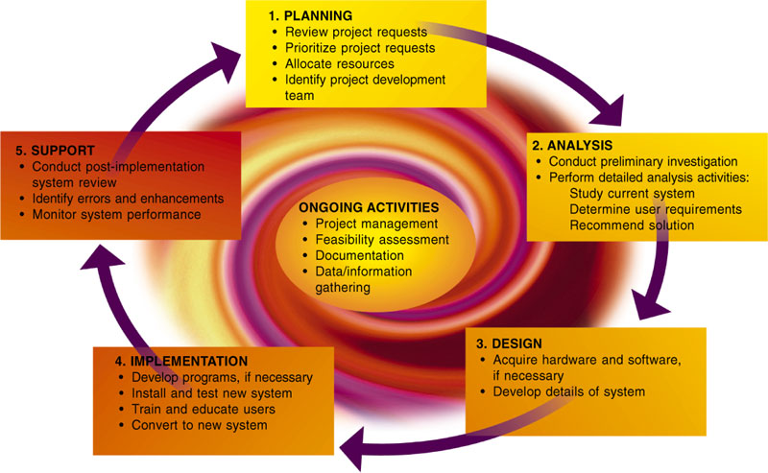
Module 01: Multi-table Systems Page C-2 SDLC
Analysis is the process of studying the current IT system to understand how it works and to identify the user’s needs.
Design is the process of developing system specifications (blueprints) for the new system, based on the information that was discovered during analysis.
Implementation is that part of the SDLC where the system is built and made operational.
Support is that part of the SDLC where ongoing support of the IT system is provided.
The accompanying graphic is taken from one of the textbooks that we use in our Intro course: Discovering Computers, by Shelly and Cashman. The SDLC that they espouse contains five stages.

Slide 10
Module 01: Multi-table Systems Page C-3 SDLC
The stages of the SDLC are usually followed in some order.
Some analysis must be completed before the design can begin. Similarly, some design work must be completed before any part of the system can be built.
The example that I’m about to walk you through jumbles up the SDLC and combines analysis work with design work. And although this is rather contrived, I think you’ll still benefit from the exercise.
At the end of it all, you’ll be expected to identify and describe the features of a database system based on a model (or diagram) of that system.

Slide 11

Module 01: Multi-table Systems Page C-4 Design: Version 1
I need a database system to keep track of the titles in my collection. At this stage I don’t need anything fancy, just something that can list all of my titles.
I can take the list with me when I’m shopping to ensure that I don’t purchase duplicates.
I can share the list with my friends so they’ll know what I’ve got, and what they can borrow (what’s mine is theirs)
--------------
I’ve modeled my system needs in the diagram.
A single table (Movies) with a single column (title)

Slide 12
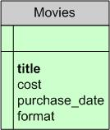
Module 01: Multi-table Systems Page C-5 Design: Version 2
I was chatting with my insurance agent and he suggested that I keep an inventory of the valuables in our home. I’ve spent quite a bit on my video collection and I think it would be a good idea to modify my database to keep track of ‘insurance’ related information now.
--------------
I’ve modeled my new system needs in the diagram.
My single table design can easily be expanded to cover these new needs.
The Movies table now has four columns.

Slide 13
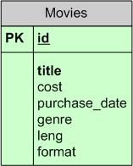
Module 01: Multi-table Systems Page C-6 Design: Version 3
My collection contains some pretty obscure titles, and it would help to have a little more information about each film.
--------------
The Movies table now has seven columns:
id
Title
Cost
Purchase_date
Genre
Leng
Format
The id column has a special notation next to it. PK stands for primary key.

Slide 14
Module 01: Multi-table Systems Page C-7 Primary Key
The primary key of any record (or row in a table) serves only one purpose: to uniquely identify that row.
Your student id, or driver’s license number, similarly distinguishes you from every other student and every other driver, even if they happen to share the same name as you.

Slide 15
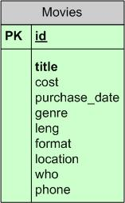
Module 01: Multi-table Systems Page C-8 Design: Version 4
Neither a lender nor a borrower be, …
I can’t recall which of my friends has borrowed which of my discs, so I’d like to modify the database so that it can keep track of who’s got what.
--------------
New columns:
location
who
phone

Slide 16
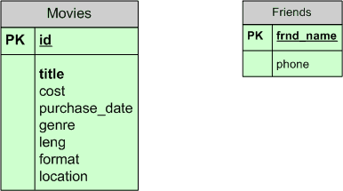
Module 01: Multi-table Systems Page C-9 Design: Version 5
I’ve been using my system for a while and I’d like to make it more efficient if I could.
Each time I loan a disc to a friend I have to type in their name as well as their phone number. I’m thinking that I should only have to type in their phone number once, and the computer ought to be able to remember it. (This is the update anomaly we spoke of earlier)
--------------
New table: Friends
None of my friends have the same name, so the name column can serve as the primary key in this new table.

Slide 17
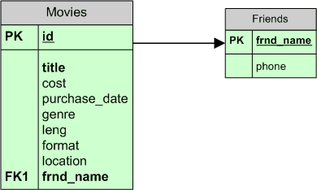
Module 01: Multi-table Systems Page C-10 Design: Version 6
And the model should represent that my friends ‘borrow’ my movies. The model/diagram should depict this relationship.
--------------
The line in the diagram represents this new relationship.
This association can be read as “friends borrow movies”.
Looking at the diagram, I can immediately see that there is some relationship between these two tables. That simple line does a good job of highlighting that feature.
But as good a job as that line does, for you and me to see the relationship, that line doesn’t mean anything to the database.
The db needs data to establish these relationships.

Slide 18
Module 01: Multi-table Systems Page C-11 Design: Version 6
And it can only establish, or represent, these relationships with data.
The data that will support this ‘relationship’ is the new column in the movies table: name. This new column, name, holds the name value from the friends table.
For example, when Dave borrows my copy of 2001: A Space Odyssey, his name (Dave) will be carried in the 2001 row of the movies table.
The name column in the movies table is a foreign key reference (FK) to a primary key in some other table.
And since there could be other columns in the movies table that serve as foreign key references, those foreign keys are distinguished from one another by the use of a subscript. This foreign key reference is the 1st foreign key reference, or FK1.

Slide 19
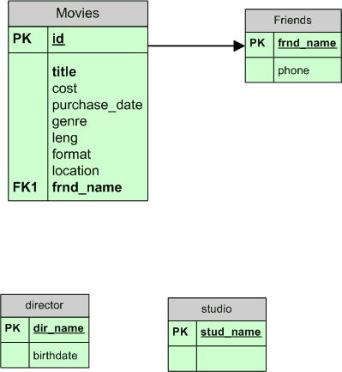
Module 01: Multi-table Systems Page C-12 Design: Version 7
I’m really getting into my movie, er, make that cinematic collection.
I’d also like to keep track of things like director and studio.
Here are the tables I’ll need, and the next step will be to add the relationships.
I want to show that
Directors direct movies, and
Movies are produced by studios
Furthermore,
Any single movie has only one director, and
any single movie is produced by only one studio.

Slide 20
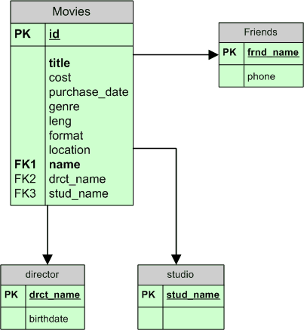
Module 01: Multi-table Systems Page C-13 Design: Version 7
Here’s the updated model.
Pay attention to the movies table. Those FK entries indicate that there are three different relationships that the movies table participates in.
One relationship uses name as a foreign key, another uses drct_name as its foreign key, and the last relationship uses stud_name as the foreign key.
Which tables do these foreign keys link up with?

Slide 21
Module 01: Multi-table Systems Page C-14 Design: Version 7
Here’s the updated model.
Pay attention to the movies table. Those FK entries indicate that there are three different relationships that the movies table participates in.
One relationship uses name as a foreign key, another uses drct_name as its foreign key, and the last relationship uses stud_name as the foreign key.
Which tables do these foreign keys link up with?
The tables that share same-named columns.

Slide 22
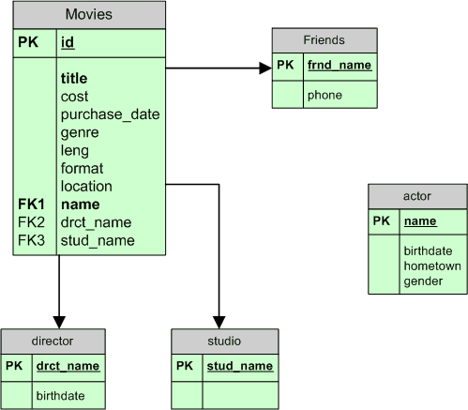
Module 01: Multi-table Systems Page C-15 Design: Version 8
Now let’s add some actor information to the database.
But how should we show the relationships?
Movies may have more than one actor, and an actor can appear in more than one movie. Hmmm. We’ve got a many-to-many relationship here, and a relational database cannot directly implement a many-to-many relationship.
The ‘trick’ is to create an intersection table that can serve as the nexus (intersection) for this relationship.

Slide 23
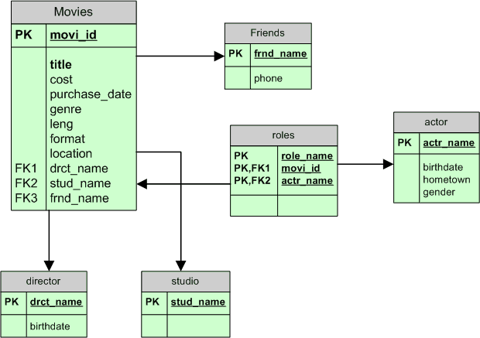
Module 01: Multi-table Systems Page C-16 Design: Version 8
The roles table has a single primary key that is a combination of three fields, or columns. All of these columns are needed to uniquely identify any row in the roles table.
A key that is comprised of more than one field is referred to as a composite key.

Slide 24
Module 01: Multi-table Systems Page C-17 Design: Mid-summary
Is your head spinning yet?
I gotta tell ya, I just love this stuff! Seriously. Database analysis and development is one of my favorite work activities. I just love modeling. Data modeling, that is. (There’s a reason some of us teach distance learning classes ;-)
But here’s the good news for you, the SQL programmer. You don’t need to be able to design, nor even draw these models.
You’re only expected to be able to read these models.

Slide 25
Module 01: Multi-table Systems Page C-17 Design: Mid-summary
If you can answer these questions, then you know all you need to know.
How many tables are there in this system?
What are the names for each of these tables?
How many columns are there in each table, and what are their names?
What is the primary key column(s) in each table?
Is there a foreign key relationship in any table?
For each foreign key relationship, can you tell me the name of the column that is the foreign key, the name of the table that it links to, and the name of the primary key column(s) in that other table?

Slide 26
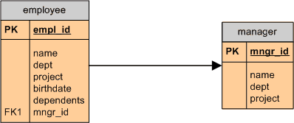
Module 01: Multi-table Systems Page C-18 Design: Version 9
Let’s consider another scenario.
We need a database to keep track of personnel in our company. We also need to highlight which employees work for which mangers.
←

Slide 27
Module 01: Multi-table Systems Page C-19 Design: Version 10
But aren’t all managers also employees? And mightn’t they also report to a manager?
This model won’t work, unless we add a manager of managers table, and then maybe another manager of managers of managers, and maybe another manager of managers of managers of managers …..
The solution (trick) is to use a recursive relationship.

Slide 28
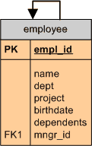
Module 01: Multi-table Systems Page C-20 Design: Version 10
A recursive relationship is used when a table has a relationship with itself.
In this example, we might say that employees manage employees.
The new column, mngr_id, serves as the foreign key reference to empl_id in this (same) table.
Let’s consider some sample data. Bob and Harry work for Sally. Sally reports to Fred. Here’s what values would be stored in the empl_id and mngr_id columns for these employees.
Row empl_id mngr_id
Bob: Bob Sally
Harry: Harry Sally
Sally: Sally Fred

Slide 29
Module 01: Multi-table Systems Page C-21 Design: Version 10
Once again, I need to remind you that you don’t need to be able to do this design work. You don’t need to be able to draw these diagrams.
As a SQL programmer, you’re only expected to be able to read these models. And, you’ll generally be able to go back to the analyst if something is unclear.
This diagramming notation that I’m using in these slides is pretty poor. It does a very bad job of highlighting the relationships between tables. To accommodate this poor capability, I suggested earlier that you could identify foreign-key to primary-key associations by looking for same named columns.
Truth is, that only works some of the time, and here’s an example where it doesn’t, where it can’t, work.
If you see a recursive relationship you’ll have to verify with the analyst which columns are used to define that relationship.

Slide 30
Module 01: Multi-table Systems Page T-1: Terminology
Single-table database
Multiple-table database
Normalization
Insert anomaly
update anomaly
delete anomaly
Systems development life cycle (SDLC)
Analysis
Design
Implementation
Support and maintenance
Unique identifier, primary key, PK
Foreign key, FK, FK1, FK2
Composite key
One-to-many relationship
Many-to-many relationship
Recursive relationships

Slide 31
Module 01: Multi-table Systems Page Z-1: End Notes
Please drop me an email if you noticed any errors in this module. I’d also appreciate reading your comments, criticisms, and or suggestions as to how this module could be improved.
Were there any gaps in the information that was presented (ie. ‘leaps of faith’)?
Was any section unclear?
Did I happen to do a good job? ☺
Thanks,
bil

Slide 32
That’s All

